Slide 1
Temperature and Humidity Sensor
Stephen Ayre, Emerson Benn, Ray Hall

Slide 2
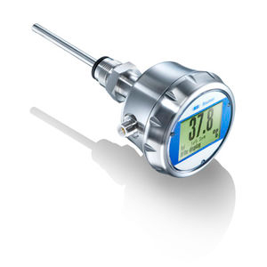
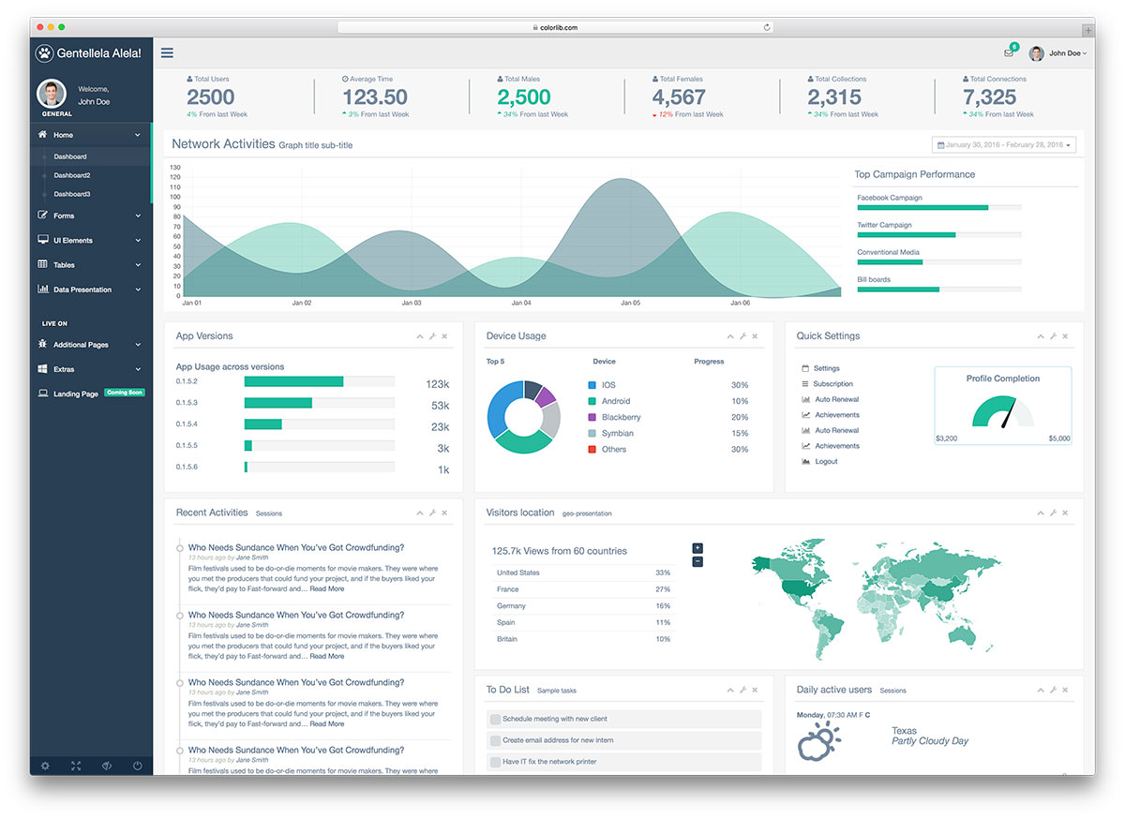
Goals
Take temperature and humidity readings every hour
Create a web application to display data

Slide 3
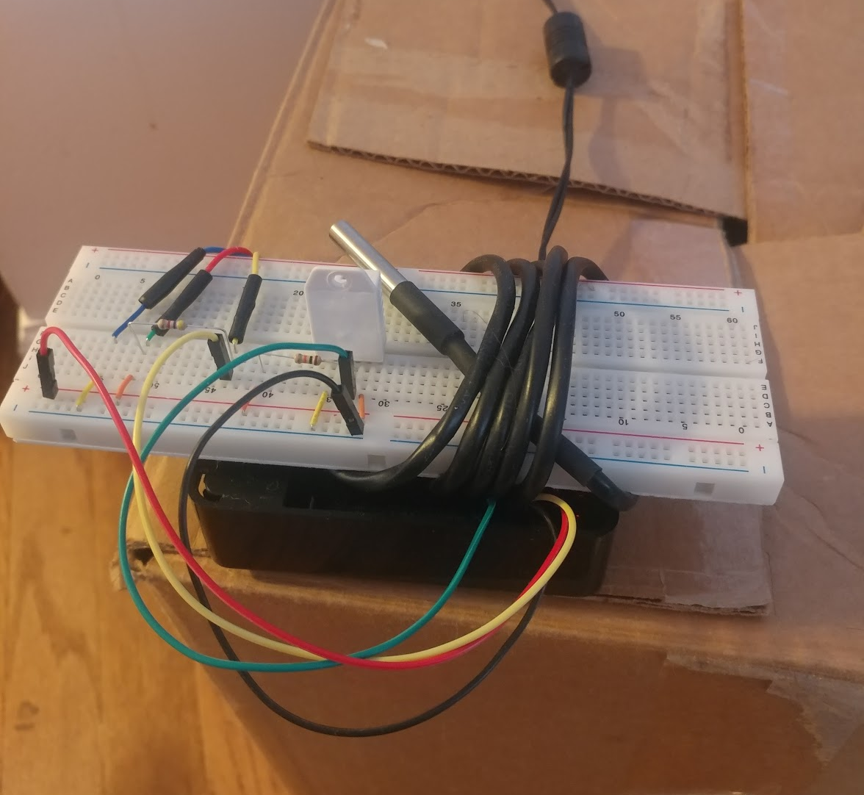
Components
Hardware
Raspberry Pi 3
Router with VPN
Adafruit DHT22 humidity sensor
DS18B20 temperature sensor
Resistors and jumpers
Software/Languages
Python
PHP
Javascript with JQuery Libraries
Apache Server
SQLite3

Slide 4
Challenges
Create a network between all of our Raspberry Pi’s and Web Server
How to display the data on dashboard
Working with SQLite3

Slide 5
Setup(Temperature/Humidity Collecting)
Setup local SQLite3 databases with each Raspberry Pi
Wired Temperature sensor and Humidity sensor to each Pi
Created Python Script to log Temperature and Humidity in database
Crontab runs Python Script every hour

Slide 6
Setup(Web Server)
One Raspberry Pi runs Apache Web Server
Other Pi’s send database files to this Pi through SCP command
Ports 80 and 443 on router forwarded to Pi’s local IP address
Apache authentication module mod_auth_basic
SSL encryption with self-signed certificate for secure password entry
Apache .conf redirects port 80 (http) to port 443 (https)

Slide 7
Setup(Web Application)
Retrieve data using SQLite3 library in PHP5
Different buttons retrieve data through AJAX calls
Display data on charts with JQuery library Chart.js

Slide 8
DEMO!!!!!!!!!!!!!!

